Slide 1
Visualizing the Relationship Between Visitor Arrivals, Hotel Occupancy, and Bus Ridership in Macao
CISC7204: Data Science and Data Visualization
Class E • Team 01 • 2026–2027 Semester 1
Fong Chin Wai (MC653748)
Fong Hio Lam (MC654953)
Kong Kin Meng (MC652817)
Kuan Chi Kit (MC653235)
Xian Qilan (MC642969)
Song Zhuoxi (MC654992)

Slide 2
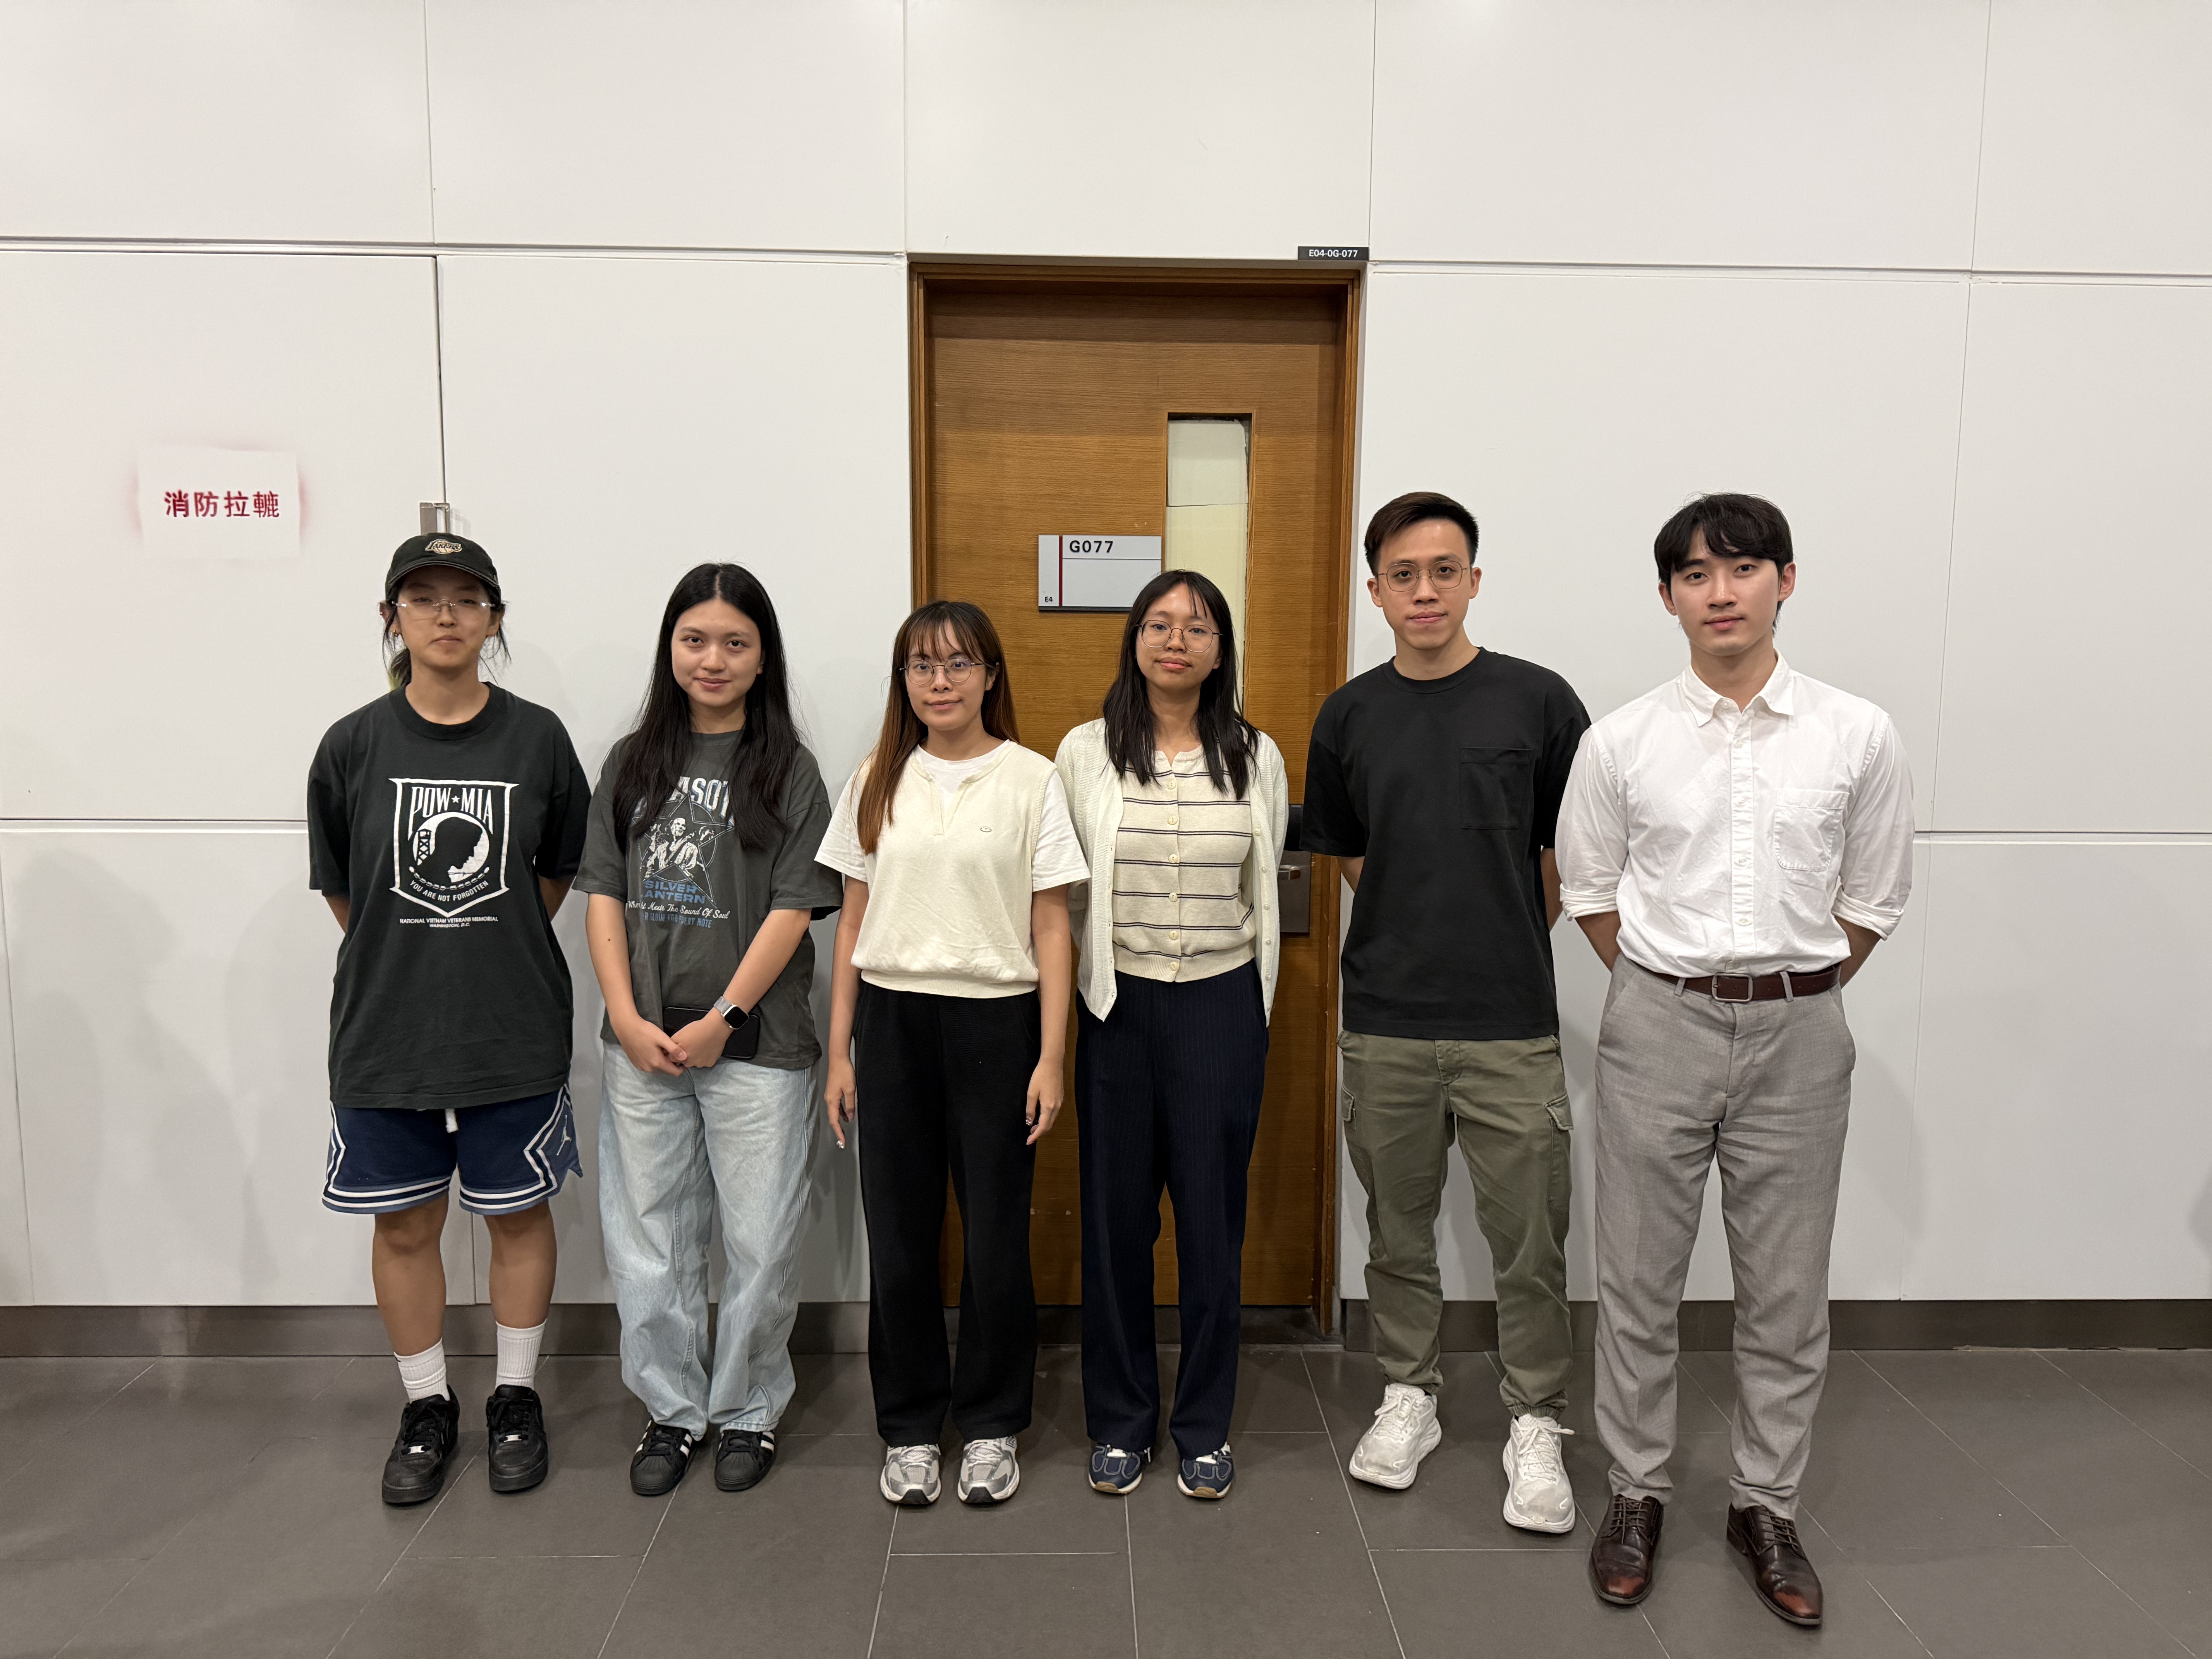
Meet the Team​
Class E • Team 01 | Six members
Team Members (From Left to Right)
SONG ZHUOXI
01
MC654992
XIAN QILAN
02
MC642969
FONG HIO LAM
03
MC654953
FONG CHIN WAI
04
MC653748
KUAN CHI KIT
05
MC653235
KONG KIN MENG
06
MC652817

Slide 3
What are we asking?
Two research questions turn a broad tourism issue into a measurable analysis.
RQ1 • Synchrony
RQ2 • Seasonality
Did monthly visitor arrivals, hotel occupancy rate, and bus ridership in Macao move together during 2023-2025?
How do the seasonal patterns of the three indicators differ across the four quarters (Q1-Q4)?
Hypotheses
H1
Visitor arrivals and bus ridership are positively correlated
H2
Visitor arrivals and hotel occupancy are positively correlated
H3
Hotel occupancy and bus ridership remain associated after considering visitor arrivals

Slide 4
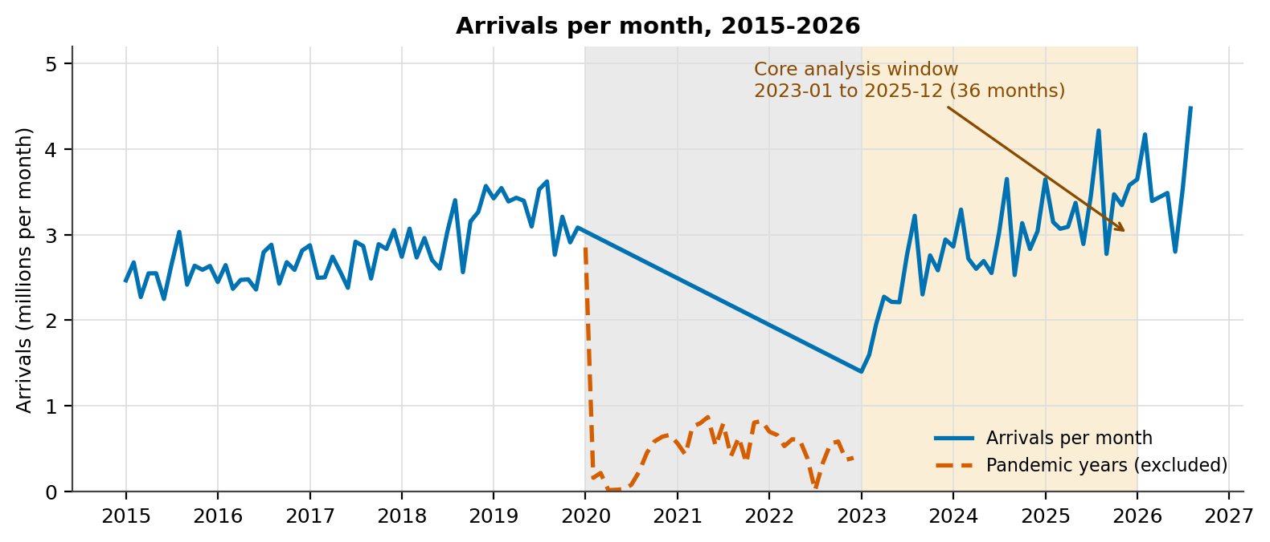
Data And Analysis Design
One auditable workflow, with the pandemic period excluded from estimation.
1
Acquire
2
Clean
3
Merge
4
Analyze
5
Result
Official tourism, hotel and bus data
Dates, units, missing values, definitions
36 monthly rows and 12 quarterly rows
Trends, correlation, seasonality, spatial patterns
Static figures and a Plotly Dash prototype
Analysis window
Jan 2023 – Dec 2025
• 36 months
• 12 quarters
• 2020–2022 excluded from statistics
• 2015–2026 used only for historical context

Slide 5
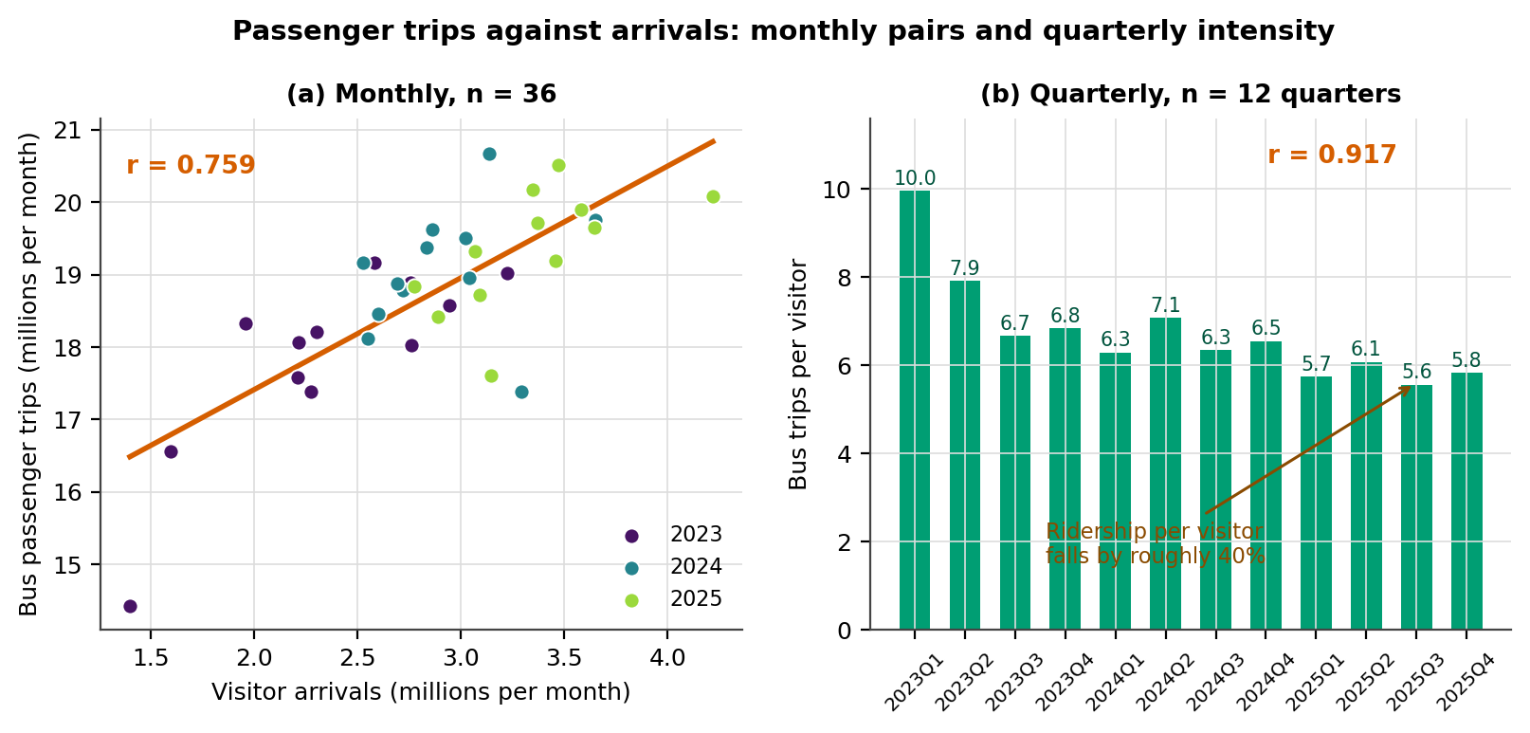
Preliminary Finding: The Indicators Rise Together
But the strength depends on the time window and level of aggregation.
What the first results say
0.759
Monthly correlation
36 months
0.917
Quarterly correlation
12 quarters
−41%
Bus trips per visitor
2023 Q1 to 2025 Q4
Interpretation
Demand grew faster than bus supply. A high pooled correlation does not mean the network adjusts one-for-one each month

Slide 6
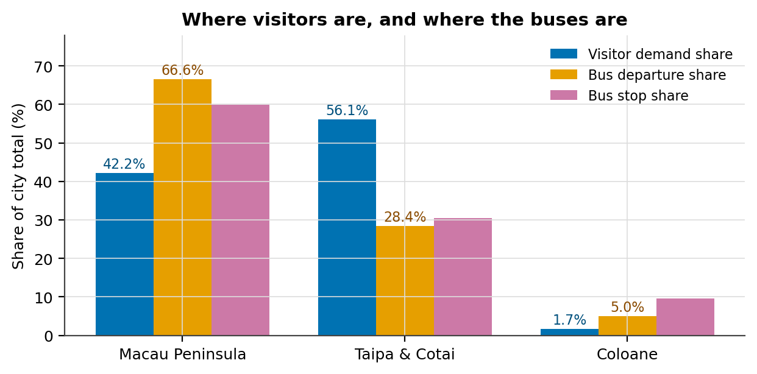
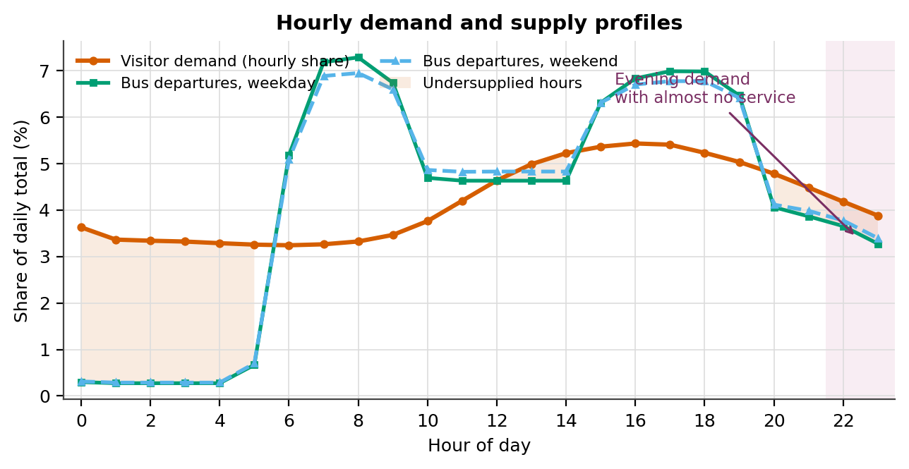
Where And When Does The Mismatch Appear?
Spatial demand concentrates in Taipa and Cotai, while service is concentrated elsewhere and at different times.
56.1% visitor demand
in Taipa & Cotai, but only 28.4% of scheduled departures
20.2% visitor volume
occurs from midnight to 05:59, versus 2.1% of weekday departures

Slide 7
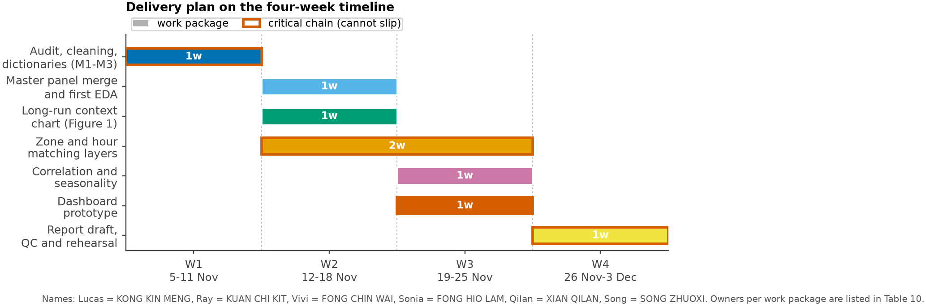
What Will The Team Deliver?
A four-week plan connects each analytical module to a concrete output.
Work structure
Modules
Arrivals • Hotel • Bus
Analysis
Correlation • Seasonality
Development
Figures • Dashboard
Quality
Reproducibility • Citations
Data package
Cleaned CSV, data dictionaries, cleaning log
Analysis
Trend, correlation, seasonality and distribution figures
Results
Report • Presentation
Dashboard
Plotly Dash prototype with district and hour controls
Final report
Reproducible notebook, interpretation and limitations
Every figure and number will be checked by a second member before submission

Slide 8
THE END
Thank you for your watching!

